Slide 1
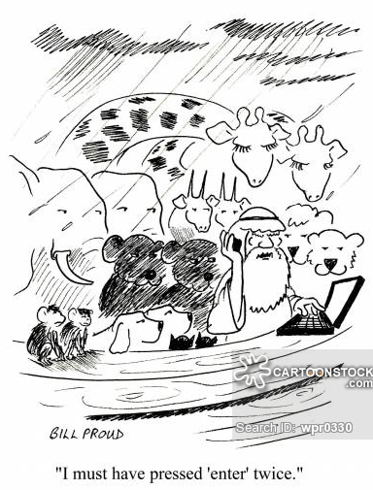
Tablet Basics and Pre-work
Supervisors and Interviewers

Slide 2
Ground Rules for CAPI Training
Take care of your tablet – charge it!
Close tablets when instructed
Keep pace with trainers
Check back on work before asking questions
Practice as instructed
Ask questions – parking lot
Have fun!
Notes:
Check back on work to be sure no keying errors – saves everybody time
Practice like we instruct – meaning, we rarely/never tell anyone to just fill in a questionnaire without practicing interviewing
Parking lot – trainers should have a flip chart available to write questions down that should be answered later (either already planned in future sessions or more appropriately answered later). Write all questions to be answered later in the parking lot so trainer is accountable to eventually answer

Slide 3
Training Plan
Data transfer throughout
Household assignments, submission of data, program updates
Presentation >> demonstration >> practice
Mock/practice interviews
Practice practice practice!
Program/translation testing throughout
Notes:
Training plan will only work if we follow ground rules
For all mistakes found in the program, translation of questions, alert lead trainer/Data Manager immediately - small treats may be provided for new errors found (not required, but helpful!). No error is too small!

Slide 4
Active Interviewing
What is active interviewing?
Paying attention to sequence of questions
Catching errors/mis-keying
Read error messages
Do NOT make up data!!!
Notes:
Be an active interviewer! This means really listen to the story of the respondent – does it make sense with what they have said? Does the question that appears next make sense with what has been said so far?
Under no circumstances should data be entered without first asking the respondent, even if previously asked and forgotten

Slide 5

Security and Caring for Tablets
Care, treat well
Government property
Use for FTF work only!
Use carrying cases
Keep charged
Don’t use internet, other than Dropbox (supervisors only)
Do not leave tablets in cars/houses
Notes:
!!! TO DO !!! Add any country-specific rules about tablet care, including amount of responsibility if damage occurs.

Slide 6
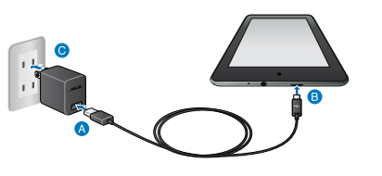
Charging the tablets
11 hours battery life
Charge whenever and wherever there is opportunity
At night, in the car, at a restaurant…
Don’t use tablet for other activities, especially when charging not readily available
American plugs…. A challenge!
Notes:
Supervisors will have extensions and car chargers
Delete American plug bullet if not applicable, otherwise discuss USB port options

Slide 7


Tablet basics and passwords
Then swipe up or hit home key to display password screen
Temporary Password:
ftf2018
Home Key
Notes:
Passwords for fieldwork will be individualized and supervisors will have a list of all passwords. For training purposes, all are the same

Slide 8
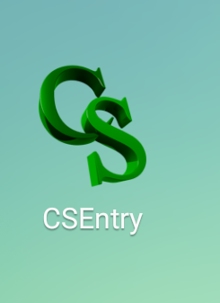
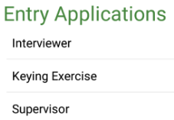
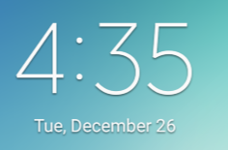
CSEntry App and Time
Times of interviews are automatically recorded… if tablet time is wrong, system may crash, data may be lost!
On home screen, check data and time!
Click desktop “application”
If wrong, contact ICDM at Implementing Agency
Notes:
All data entry programs can be found in the CSEntry app on the desktop – during fieldwork, interviewers will only have Interviewer program option. Keying Exercise is for training only.
If time must be corrected, ICDM may have to do it (depending on IA’s security policy) because a system password may be required.

Slide 9

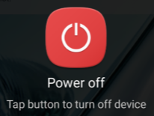
Powering down
Power down as often as possible!
Sleeping between households is sufficient – but on breaks, power down
Notes:
Tables go to sleep after 5 minutes of inactivity – sufficient between households

Slide 10
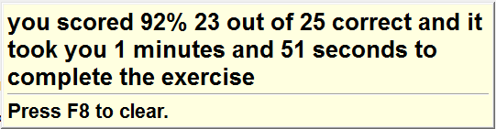
Keying Exercise
Double click on desktop icon:
Notes:
Main menu - create a new exercise or view report of your progress… or quit
Copy what is on the left – use different methods of entry
Demo key exercise on laptop!
Then have teams do it

